Slide 1


Design and Integration: Part 2
Going Agile on Design…
Notes:
Image of agile person from http://www.htxt.co.za/2013/07/03/agile-africa-conference-announced/

Slide 2

Why would you want to design?
…when you could start coding today!
Notes:
Image from http://cycling74.com/2012/09/11/working-with-hardware-dmx-part-2/

Slide 3

Design is dead?
Fowler’s contentions:
“In common usage, evolutionary design is a disaster.”
You can’t build a skyscraper like a doghouse.
You can’t hand-off work without a plan.
Once you’ve got this in Sprint 1, can you just evolve it?
Notes:
Image of a design prototype from http://www.domusweb.it/en/design/2011/08/31/states-of-design-04-critical-design.html

Slide 4
But why is upfront design bad?
Tension between designers and developers
Requirements change
Good design can accommodate that change! But it must correctly anticipate the KIND of change.
Maybe because you didn’t understand them at first – better requirements!
But also requirements change due to business changes – can’t easily plan.

Slide 5
How do you do design?
A series of at least 3 steps, maybe more.
What are those steps?
Do this on a Computer so you can easily add/modify steps.
Remember this is a “loose artifact” later!
You need to remember to keep it up to date.
Fowler’s “changing requirements.”

Slide 6
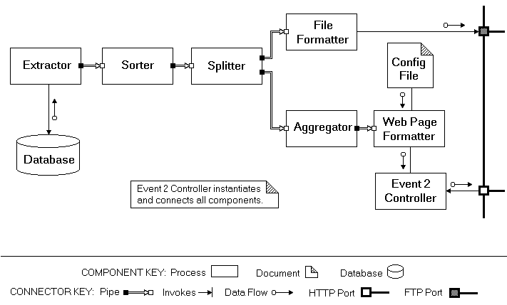
Always involves…
Iteration
Because you can’t get it right the first time.
Abstraction
At various levels.
The very abstract is very tricky.
What if the designers don’t code?
High-level architecture for an Event Processor
Notes:
Design from http://www4.desales.edu/~dlm1/it533/class03/pipe.html

Slide 7
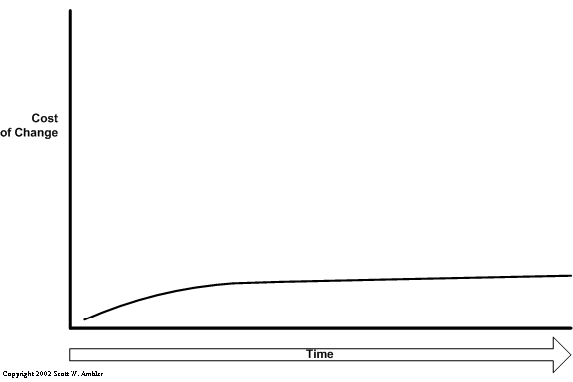
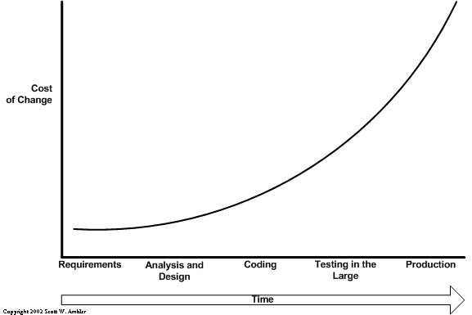
Fowler on XP
How do you avoid the “exponential curve” of costs as you change things to a delivered system?
But you have to do the “enabling practices”!
Kent Beck’s version!
Notes:
Images from http://www.agilemodeling.com/essays/costOfChange.htm
Play the slide show to see the first image, then the second.

Slide 8
Some of this is economics
If the customer is doing “pay as you go,” then they’ll balk at paying for a lot of design up front.
And you could get it wrong… and eat those costs.
A simple system:
Runs all the tests
Reveals all the intention
No duplication
Fewest number of classes or methods
Notes:
The definition of “simple system” is from Kent Beck.

Slide 9
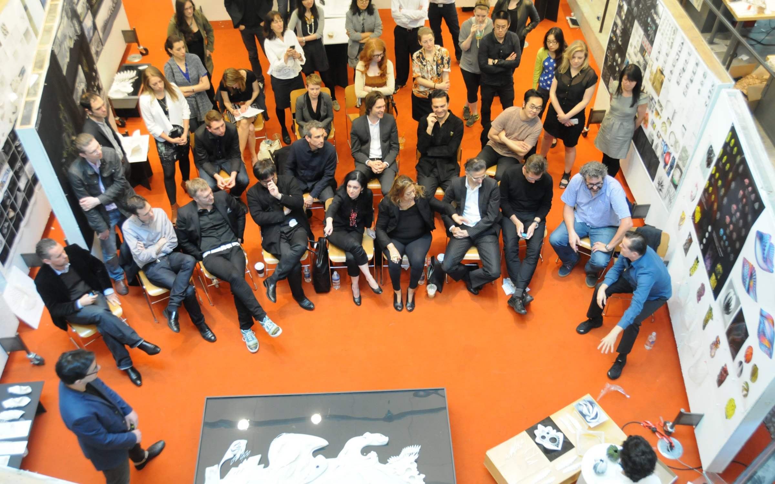
Some of it is social
Someone has to explain design to someone else.
Like all the stakeholders.
Notes:
Image from http://architecture.yale.edu

Slide 10

Frameworks
Common question!
A great enabler
Also dangerous
Takes time to get up to speed
Takes time
No value is delivered
What if you are wrong?
A huge gold plating operation
“Every class decorates some other class!”
Notes:
Decorator – See http://en.wikipedia.org/wiki/Decorator_pattern
Cookie decoration image from http://bakefresh.blogspot.com/2010/09/daring-decorated-sugar-cookies-with.html#.VEj6Br7selk

Slide 11
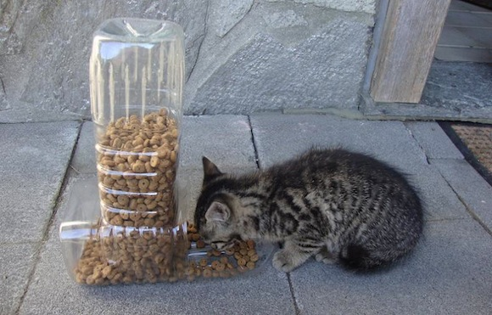
Reuse?
Good idea?
What would Highsmith think?
Adaptation over anticipation (p 217)
But – depends on “maleability of the medium.”
Architectural decisions are often expensive.
The overall goal is “low cost.”
Notes:
Reuse image from http://digitalsynopsis.com/design/20-creative-ways-to-reuse-old-stuff/

Slide 12
Recall the standard design sequence
In all of engineering, it goes like this.
You at least need a good problem statement.
It should cover functional and non-functional requirements in generality.
You do the high-level design from that.
Top-down, with lots of alternatives.
Then pick from those, based on lots of criteria.
This is Phillips’ “Abstraction” (p 262)
Then you use the detailed requirements to fill-in the detailed design.
Bottom-up.
Do you need to express this, beyond coding?
Like?
Why?

Slide 13
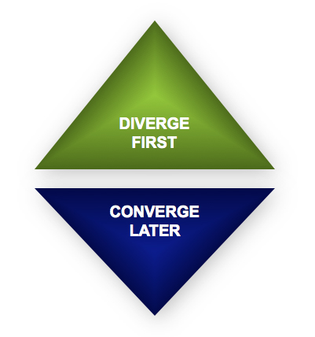
High-level design looks like good brainstorming
Try not to mix these two:
Coming up with new ideas.
Picking one, and focusing on how to do it well.
But,
For everything beyond coding, you have to maintain it forever!
So – Is it throwaway?
Start with 1 problem
Get lots of ideas!
End with 1 solution
Notes:
Image from http://www.creativerealities.com/innovationist-blog/bid/103494/Let-s-not-confuse-good-brainstorming-with-the-new-Groupthink

Slide 14

Fowler and Fowler…
One way to deal with changing requirements is to build flexibility into the design so that you can easily change it as the requirements change.
However this requires insight into what kind of changes you expect.
A design can be planned to deal with areas of volatility,
while that will help for foreseen requirements changes,
it won't help (and can hurt) for unforeseen changes.
So you have to understand the requirements well enough to separate the volatile areas, and
Our observation is that this is very hard.
Can the egg know how the chicken is going to turn out?
Notes:
Chicken and egg image from http://www.swamij.com/chicken-egg-nondualism-god.htm

Slide 15
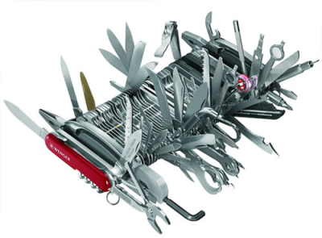
Does Refactoring Violate YAGNI
No, because we have a more complex definition of “simplicity”
Simple = the easiest to work with code, overall.
If the product lives for 10 years, better-written code really pays off.
E.g., living with a big, messy case statement, versus a set of subclasses that do those cases.
Pocket knife, after 10 years
Notes:
Image of gold plating in action, from http://blog.thescrumster.com/?tag=yagni.

Slide 16
Design Patterns?
Knowing them is good, Fowler thinks (we agree)
But just the slightest bit dangerous
Using design patterns always has a cost
Good in that everyone knows them.
Maybe not so good if coding to them takes a lot of effort.

Slide 17
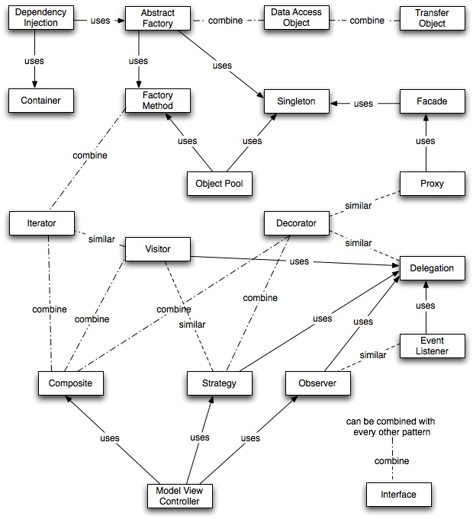
Design Patterns?
And here they are…
Lots more in other courses we teach.
Notes:
Relationships of the patterns – image from http://best-practice-software-engineering.ifs.tuwien.ac.at/patternmap.html

Slide 18
Can Refactoring Lead You To Patterns?
Maybe –
More often, programmers refactor to patterns. Like,
To get rid of a talking to some interface that keeps changing, I consolidate where I have to do that, into an “interface” class. Or,
To get make a bunch of little variations on a class, I “decorate” it with these separate additions as wrappers.
Lots more on refactoring is also on the web!
Notes:
Refactor to the strategy pattern -> students sorted by name, students sorted by grade, students sorted by birthday

Slide 19
Design also should be more than English language statements!
Add diagrams:
First keep in mind what you're drawing the diagrams for. The primary value is communication.
Effective communication means selecting important things and neglecting the less important…
Don't draw sequence diagrams for all use cases and scenarios – only [the important ones]..
A common problem with the common use of diagrams is that people try to make them comprehensive.
The code is the best source of comprehensive information, as the code is the easiest thing to keep in sync with the code.
For diagrams, comprehensiveness is the enemy of comprehensibility.
Notes:
From Fowler’s article

Slide 20
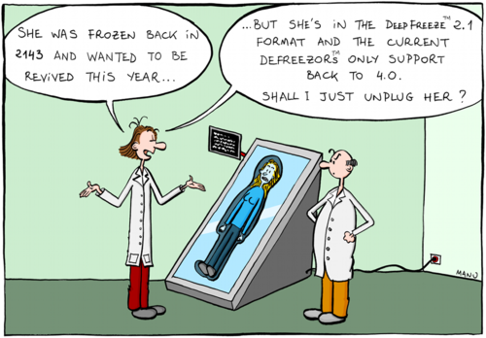
Are there things worth “planning in”?
Desires of the customer
Technical Risk
Ability to get it right “up front”
Notes:
Cartoon from http://myitforum.com/myitforumwp/2012/08/20/application-compatibility-think-holistically-to-get-it-right-the-first-time/

Slide 21

Personalities weigh in
What role does an architecture play when you are using evolutionary design?
XPs critics state that XP ignores architecture, that XP's route is to go to code fast and trust that refactoring that will solve all design issues.
Interesting if they are right!
Certainly the most aggressive XPers - Kent Beck, Ron Jeffries, and Bob Martin - are putting more and more energy into avoiding any up front architectural design.
E.g., Don't put in a database until you really know you'll need it. Work with files first and refactor the database in during a later iteration.
“Uncle Bob” Martin
Notes:
Bob Martin’s picture from http://scna2012.softwarecraftsmanship.com/speakers
Text is from Fowler’s article.

Slide 22
Revisiting the tension
In general, [an architect] conveys a certain gravitas, as in "I'm not just a mere programmer - I'm an architect".
This may translate into "I'm an architect now - I'm too important to do any programming".
The question then becomes one of whether separating yourself from the mundane programming effort is something you should do when you want to exercise technical leadership.
This question generates an enormous amount of emotion.
Notes:
Text is from Fowler’s article.

Slide 23
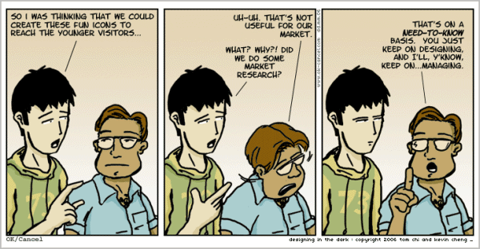
Any time you distinguish roles, you have similar problems…
Notes:
Cartoon from http://www.hongkiat.com/blog/comic-strips-designers/

Slide 24
What’s an architect have to do? - 1
Desired qualities for a software architect include the following:,
The artistic skill to make seemingly simple designs that are easy to grasp and yet which solve complex problems.
Analytical skills, such as an ability to find root causes for high-level problems in existing designs, like why a system runs too slowly or is not secure.
A systems engineer's understanding of the business, social, and operational environment in which a system needs to operate. An understanding of the domain in which a system will live, as well as technical knowledge.
Ability to relate to a wide range of stakeholders, including the client, users, system administrators and suppliers.
Communication skills - explaining to a design to the people who need to implement it.
A working knowledge of the capabilities of the development organization, and of how to explain to them what to do. This normally includes a high-level of adeptness at using the required technologies. The architect often writes a framework, which is developed further by others on the team.
Notes:
List is from a current paper being authored by Chenoweth and Rupakheti.

Slide 25
What’s an architect have to do? - 2
And,
Knowledge of multiple technologies, from which to choose the right ones for the next job.
Ability to conceptualize the strategic requirements for a project, which translate into needed design features.
Negotiation skills, so as to stand up for technical decisions that require change by developers and stakeholders.
Teamwork skills, such as listening to opinions of other developers and testers.
Technical leadership skills, during development and delivery of a system. These include also the selling skills used to convince stakeholders and developers of the soundness of a technical approach.
Lots more about this in our software architecture course!

Slide 26
Living in Flatland
The fundamental assumption underlying XP is that it is possible to flatten the change curve enough to make evolutionary design work. This flattening is both enabled by XP and exploited by XP. This is part of the coupling of the XP practices: specifically you can't do those parts of XP that exploit the flattened curve without doing those things that enable the flattening.
Notes:
Text is from Fowler’s article.

Slide 27

Flat is a state of mind?
In his XP 2000 paper, Josh Kerievsky points out a good example of this. He looks at possibly the most public XP code of all - JUnit.
JUnit uses decorators to add optional functionality to test cases, such things as concurrency synchronization and batch set up code.
By separating out this code into decorators it allows the general code to be clearer than it otherwise would be.
But you have to ask yourself if the resulting code is really simple. For me it is, but then I'm familiar with the Decorator pattern. But for many that aren't it's quite complicated.
Notes:
Image of Kerievsky from http://agiles2010.agiles.org/lang/en/2010/04/keynote-speaker-joshua-kerievsky/
His XP 2000 paper is at http://www.industriallogic.com/wp-content/uploads/2005/09/PatternsAndXP.pdf
Text is from Fowler’s article.

Slide 28
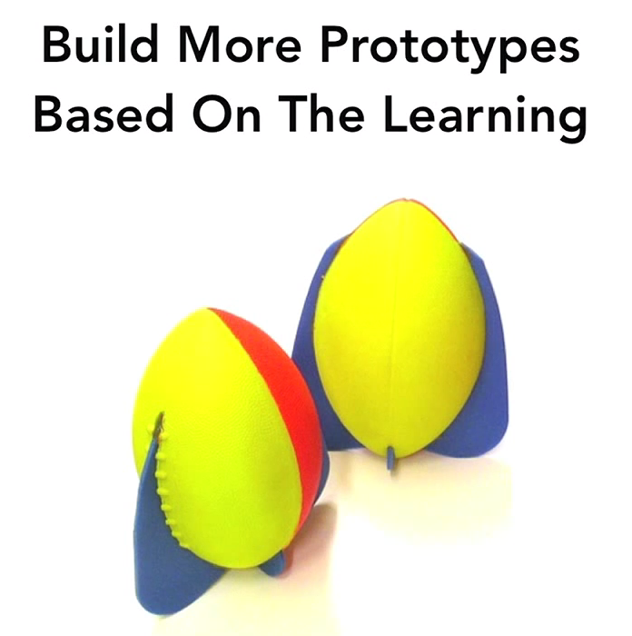
Design at IDEO
See Chris Milne’s TEDx video at https://www.youtube.com/watch?v=YzET-qlE1kQ
How is this like Agile?
How is it like “Old school”?
How is it like Spiral?

Slide 29
Summary for requirements and design
“Old school”
Agile
Trust people in charge of:
Requirements gathering
Design creation
Trust things you hand off using documents:
People sign-off on these.
Don’t trust the code, unless verified vs documents.
Hierarchies of people coordinate the info flows.
Delegate responsibilities.
Get it right the first time.
Trust nobody, unless:
They are standing right in front of you! And,
They are the right person.
Don’t trust your own documents:
People guess on those, and
You’re stuck with updating!
Except for the code, which is always before the customer.
Flatten the hierarchies.
Empowered teammates move fast.
Get it right eventually.

